Slide 1



Action Civics Initiative
Professional Development Session #4
March 12, 2016
8:45 am – 3:30 pm

Slide 2

Welcome Back!

Slide 3


All opinions count; Keep an open mind
Keep side conversations to a minimum
Do what works (honor different styles)
Use your technology for relevant topics Be open to ideas; use what you learn
Stay true to your idea and passion
Actively listen and participate
Decisions by consensus
Ask for clarification
Focus on the kids
Maintain trust
Phones on silent
Respect time

Slide 4

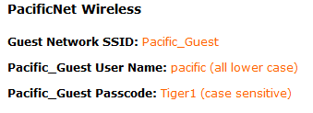

Agenda
Materials
Logistics
Outcomes

Slide 5

Outcomes
Hear from your colleagues about how to set up school forums, a speaker series, larger school wide events to promote greater civic awareness among staff and students;
Learn about the FAIR Act and what schools should be doing to comply with it;
Receive logistical information about the Spring Showcase;
Discuss ways to maintain student engagement in the face of adversity;
Learn more about efforts to influence policy around civic engagement,

Slide 6

What’s
New?
(or What I did last weekend.)

Slide 7
Opportunities…
LegiSchool Real World Civics Summer Internship
(flyer in packet)
Choices Immersion Program for New Leaders:
http://choices.edu/pd/institutes/institute-2016-ca
  July 27-29, 2016
  Become a ChoicesTeaching Fellow
  Application due April 28
Steinberg Campaign looking for interns and
volunteers (flyer in your packet)
County Mock Election (letter in your packet)

Slide 8


Online Resources…
http://www.kellygallagher.org/article-of-the-week/
http://ww2.kqed.org/lowdown/
www.electoraldysfunction.org

Slide 9
Hearing from the experts…
Forums, Speakers, and other events
Linda Reed, Rio Americano HS
Yvette Rios-Siemers, Monterey Trail HS
Chelsey Fernandez, Pinkerton MS

Slide 10

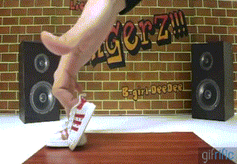


Slide 11

Stephanie Cook and Farrah Poladi
Carver High School
FAIRclassrooms.com/resources

Slide 12
Action Civics Showcase
April 30, 8:30am – 2:00pm
Statewide Civics Showcase:
9:00am – 10:30am
Local showcase of projects:11:00am – 2:00pm

Slide 14
Statewide Civics Showcase
Videoconference with Los Angeles showcase
Speakers at both venues:
  Sacramento: State Superintendent Tom Torlakson, Superintendent David Gordon, Roger Niello, Mindy Romero (UC Davis)
  Los Angeles: Secretary of State Alex Padilla, LACOE Superintendent, LA Chamber of Commerce

Slide 15
Statewide Civics Showcase
Student moderator at each venue
Students can submit real time questions to the panels via Twitter #

Slide 16
Students may set up their project displays between 7:30 – 8:30am
1-2 projects per table (depending on the size of the project
Some electricity will be available (let me know if you need it)
Science fair/ Trade show format (Gallery Walk)
Project boards, PPT or video presentations (on laptop), ???

Slide 17
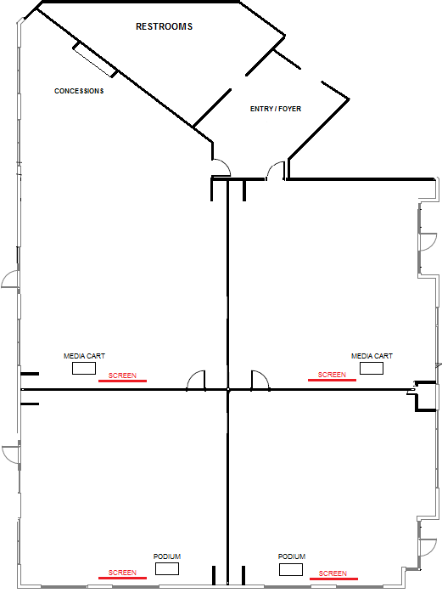
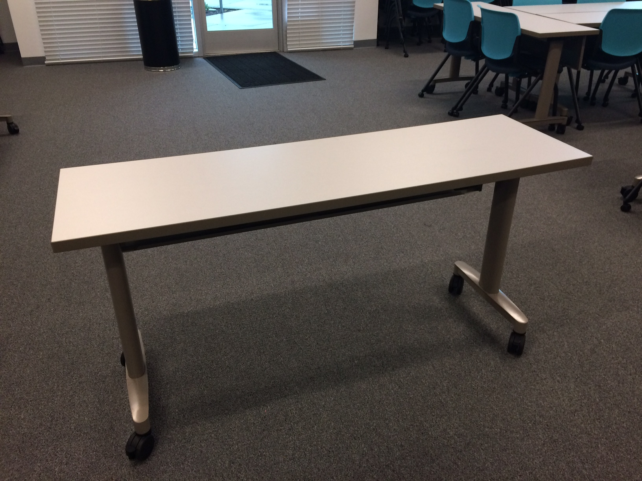
Student Projects
FOOD!
Over 110
tables in the Conference Center
Chairs
Panel

Slide 18
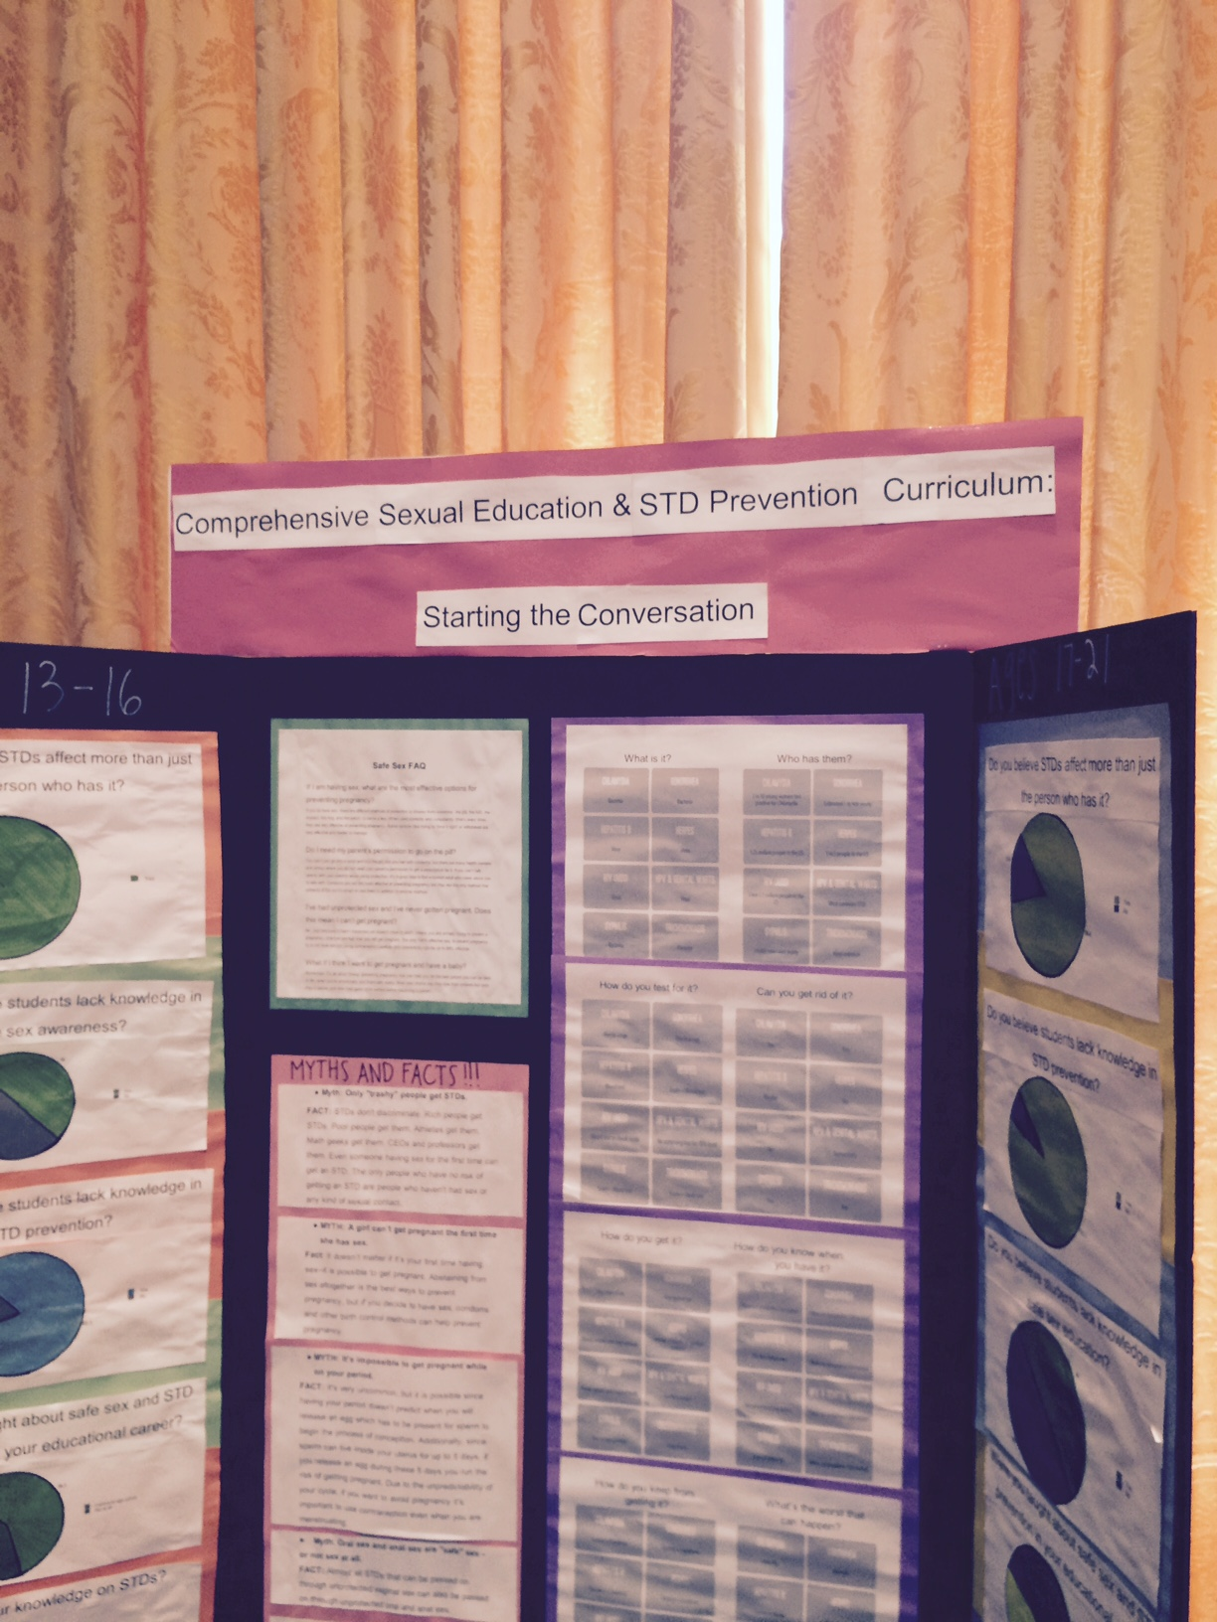
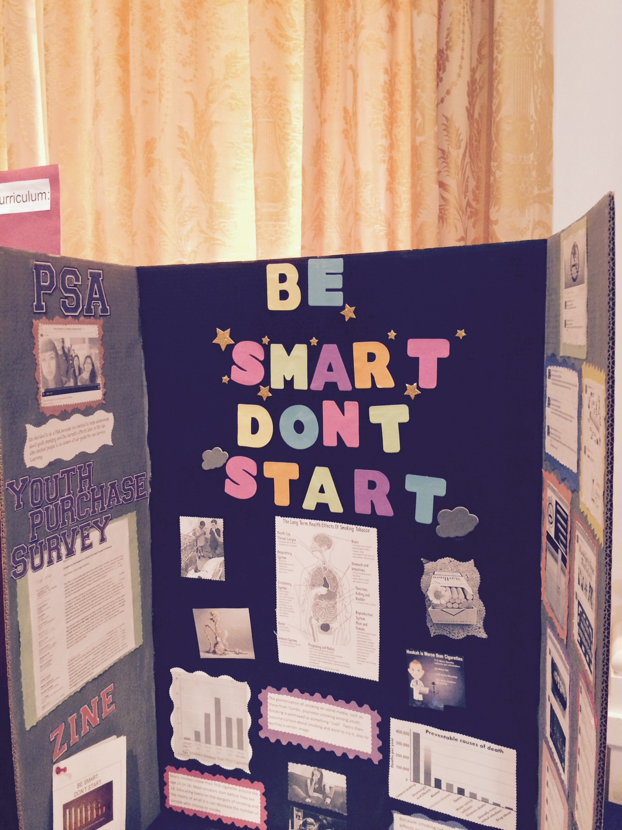

Slide 19
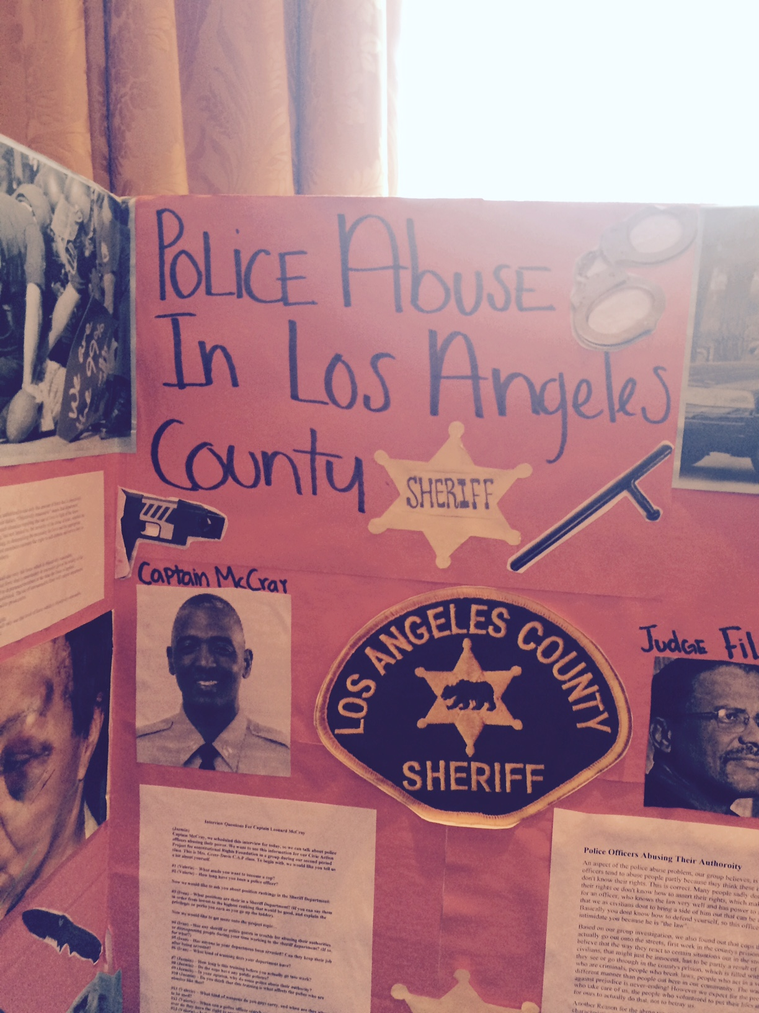
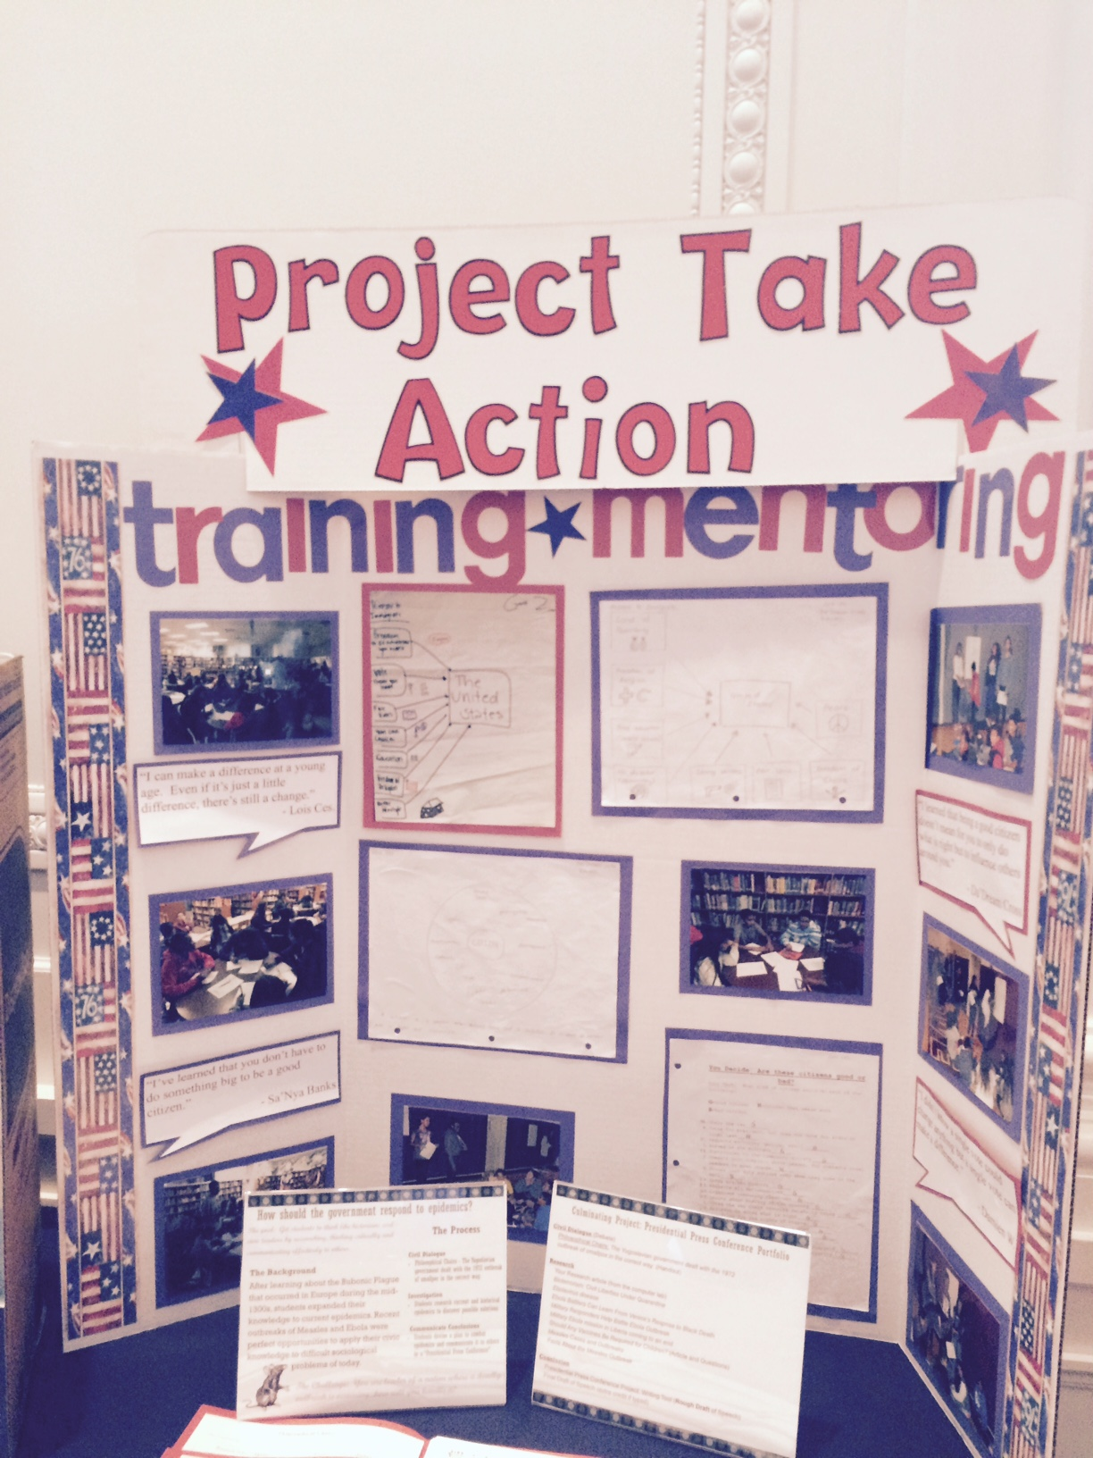

Slide 20
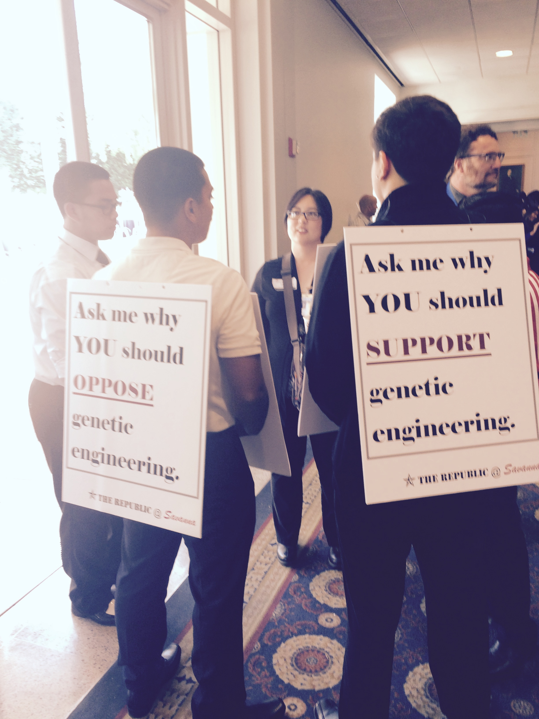
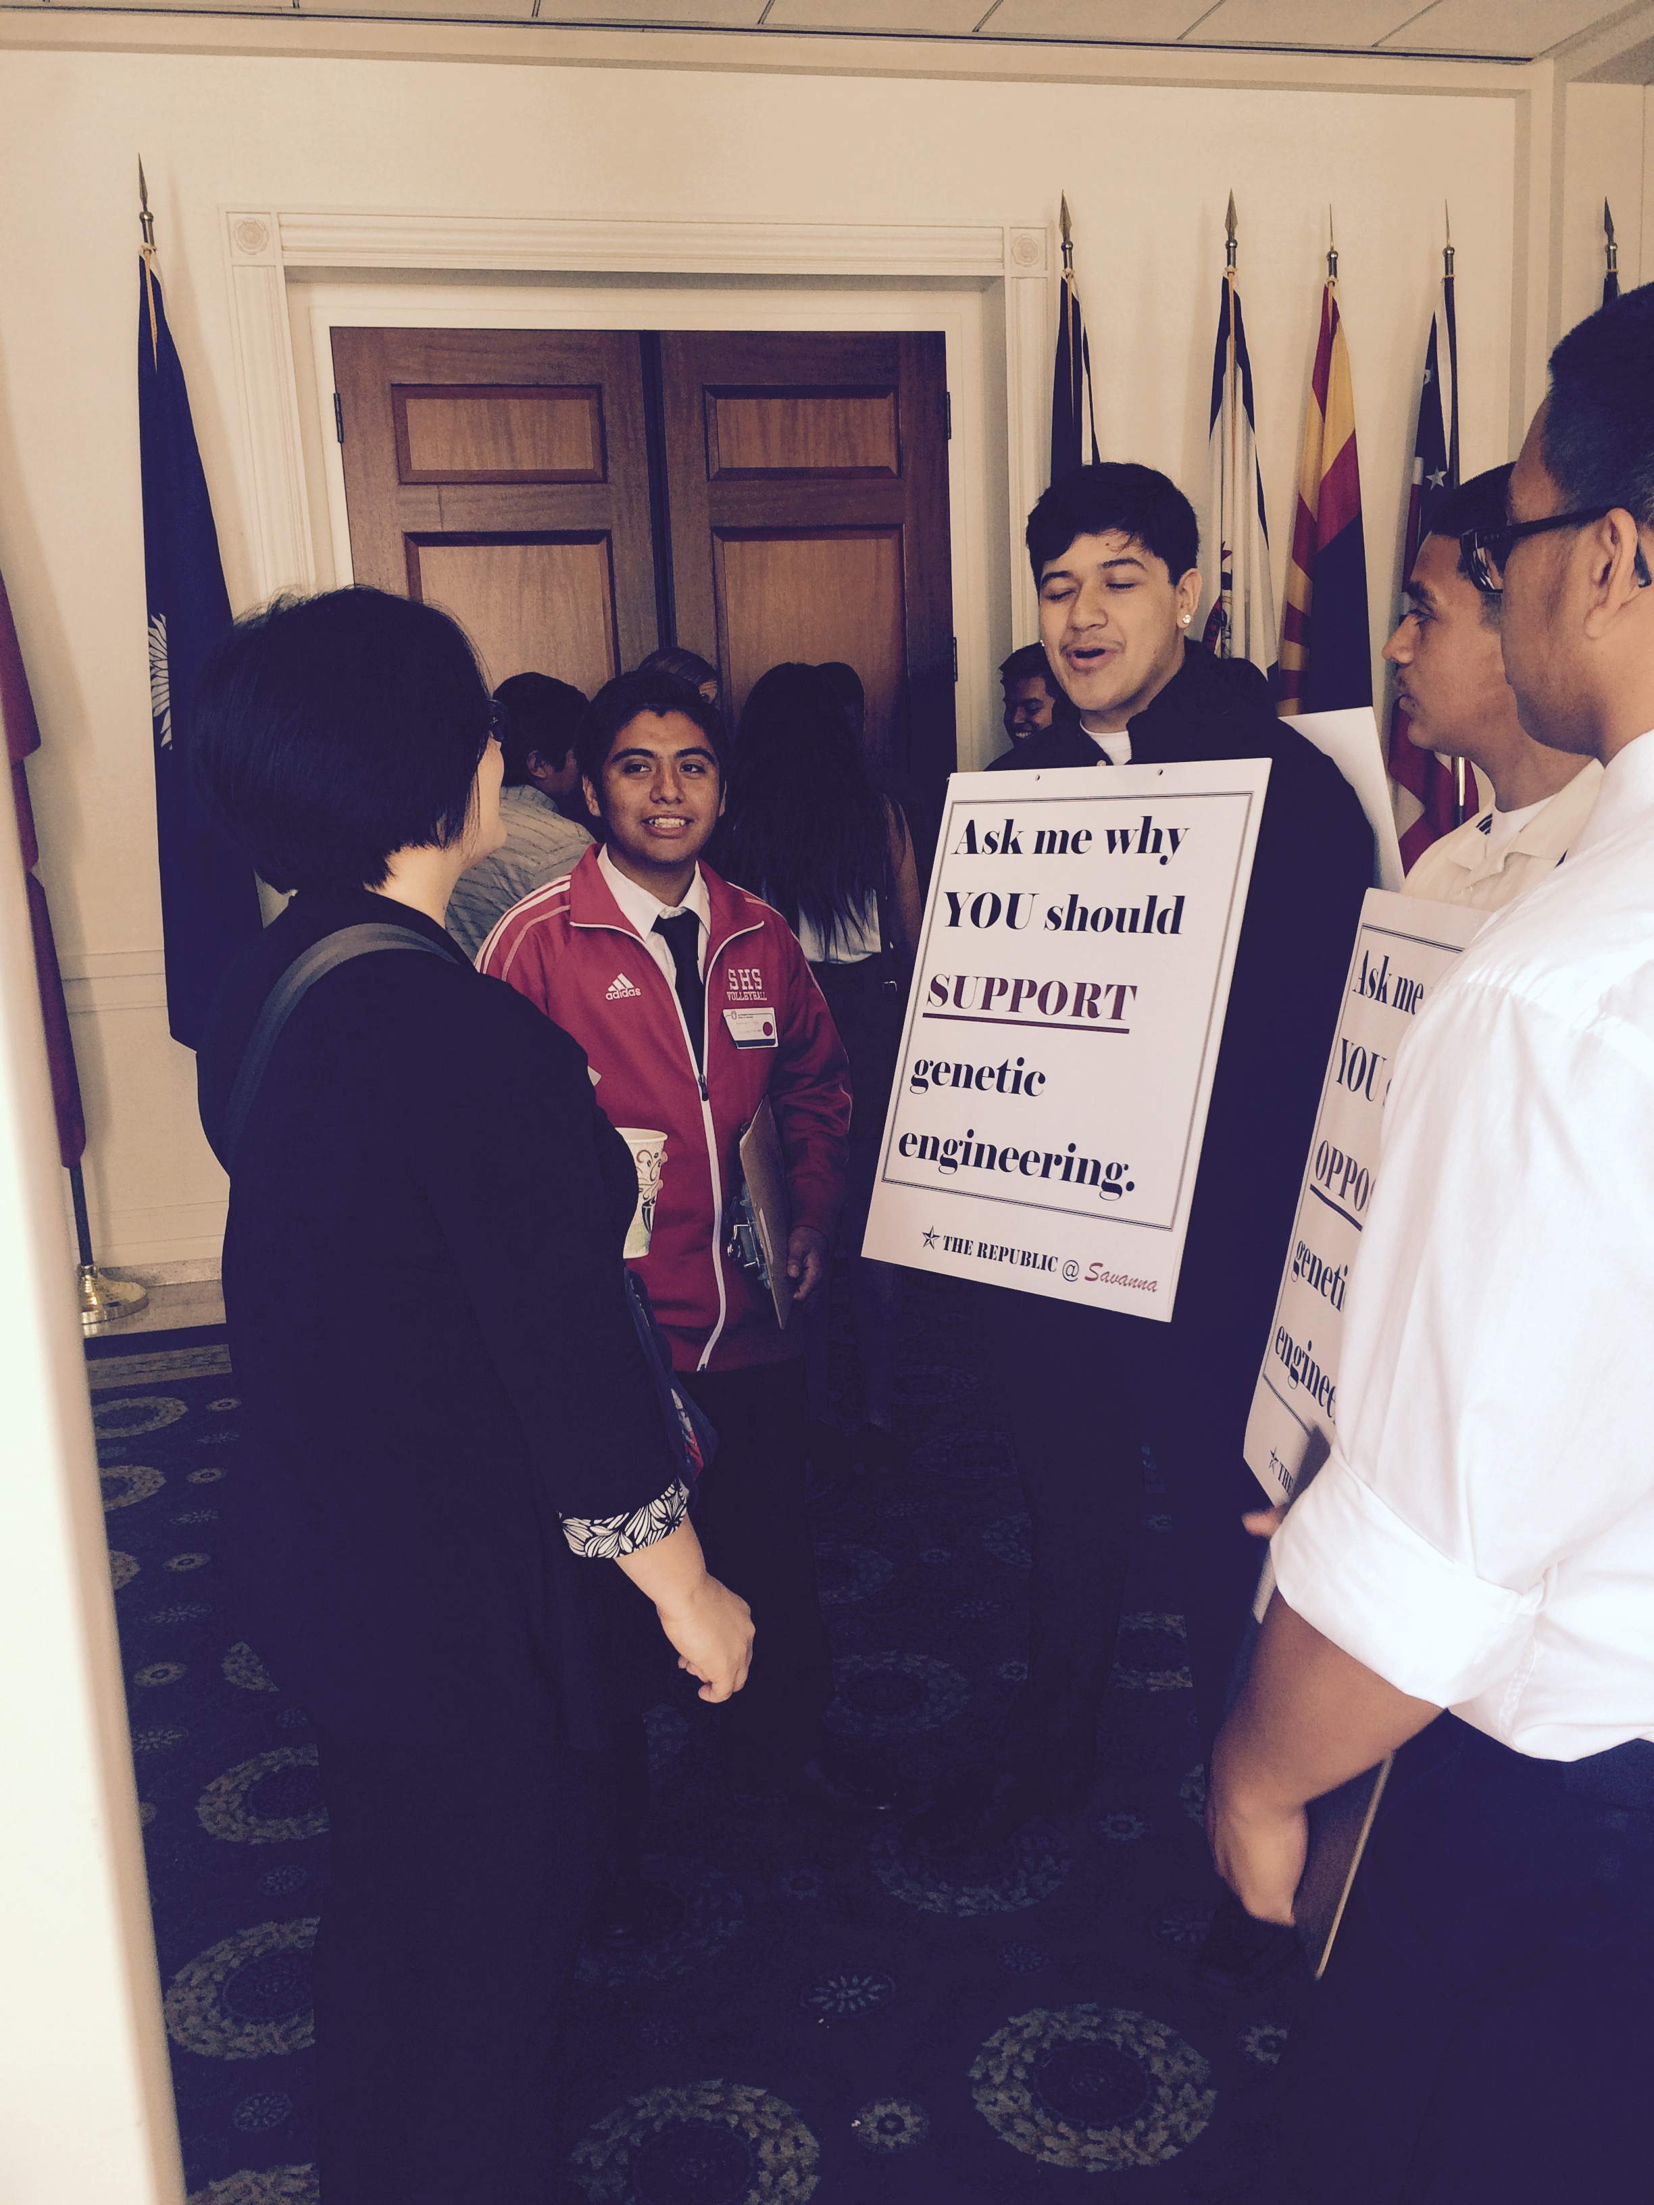

Slide 21
Regardless of the method of presentation…
Tell your story!
  Documentation of the PROCESS
  Identify an Issue, Research, Choose a Side, Develop a Strategy, Act
Participants (visitors) will ask students questions about their projects

Slide 22
What I need to know from each site…
Exact number of projects you’re bringing to the showcase
  Title
  Do you need a power outlet?
  Names of students presenting
  Names of other students attending
Names of any VIPs coming from your site
  Principal, VP, Non-AC Staff
Link to a Google Doc will be sent to Team Leads

Slide 23

Showcase Questions?

Slide 24

Civic Engagement: A double edged sword
We teach students to be civic minded
and change the system.
To do that, they must engage the system that needs to be changed.

Slide 25

Maintaining Engagement in the Face of Adversity:
Five Perspectives

Slide 26
Five articles, Five Perspectives
How Poverty Affects Classroom Engagement Educational Leadership
Using project-based learning to engage students with politics
The Guardian
How to use Optimism to Defeat Adversity
Forbes Magazine
Three Ways to Turn Setbacks into Progress
Harvard Business Review
Ten Steps to Better Student Engagement
Edutopia

Slide 27
Five articles, Five Perspectives
Find your teammates (look inside your folder)
Read your article
Complete the note sheet (individually)
Connect with your team to complete one “note sheet” on chart paper
Post your team’s paper on the wall
GALLERY WALK!

Slide 28

How Poverty Affects Classroom Engagement Educational Leadership
Using project-based learning to engage students with politics
The Guardian
How to use Optimism to Defeat Adversity
Forbes Magazine
Three Ways to Turn Setbacks into Progress
Harvard Business Review
Ten Steps to Better Student Engagement
Edutopia

Slide 29
Five articles, Five Perspectives
Find your teammates (look inside your folder)
Read your article
Complete the note sheet (individually)
Connect with your team to complete one “note sheet” on chart paper
Post your team’s paper on the wall
GALLERY WALK!

Slide 30
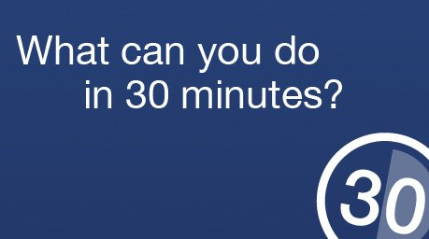

Eat LUNCH!

Slide 31

Follow up session:
How have people used gapminder.org in their classrooms?
Successes? Challenges? Questions?

Slide 32
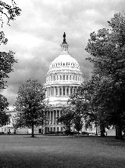
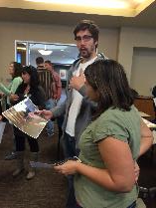
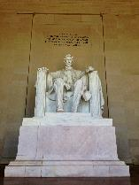
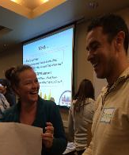


Action Civics, The Power of Democracy, and Sacramento’s Implementation Team
David W. Gordon
Roger Niello

Slide 33


Action Civics helps implement the State Civic Learning Task Force recommendations

Slide 34
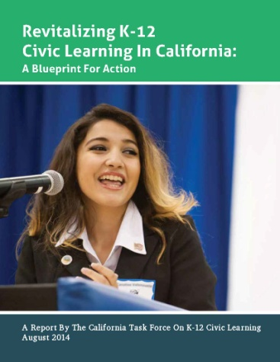
Task Force on K-12 Civic Learning:
Highlights of Recommendations
Integrate civic learning into standards/frameworks
Provide professional learning in civic learning
Develop a K-12 articulated sequence
Link schools and community
Provide equal access to high quality civic learning
Integrate civic learning into assessments and Local Control Accountability Plans
Notes:
Review Task Force Recommendations

Slide 35
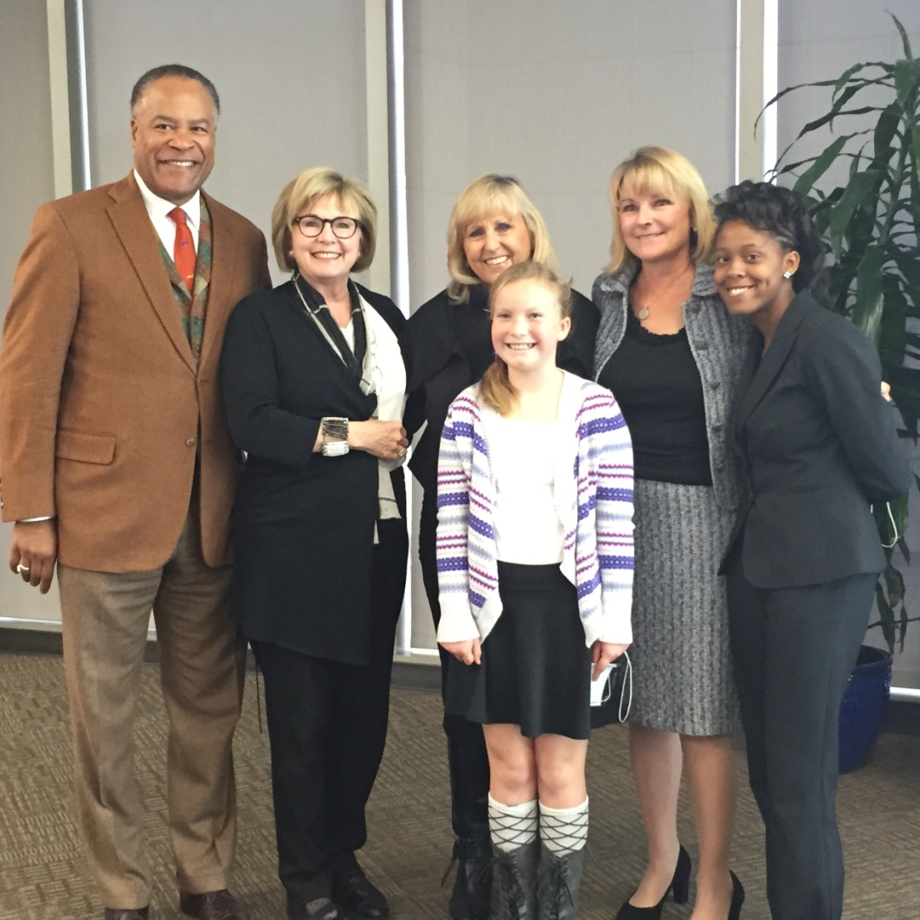
Task Force Implementation
State Level:
Frameworks
Assessment
Accountability
Communications
Local Level
Pilot Civic Learning Partnerships in Six Counties:
Implementation Plans
School Board Resolutions
  Alameda
  Los Angeles
  Butte
  San Diego
  Fresno
  Sacramento
Sacramento Implementation Team Leaders:
  Business (Roger Niello)
  Education (General Davie)
  Courts (Hon. Ron Robie)
Notes:
Review work at state level:
ELA/ELD Framework
Social Studies Framework
Six Pilot Local Partnerships
3 leaders – business, judiciary, education
Have a breakfast to introduce to the Task Force report –
Invite community to join partnership
Reach out to school boards
Provide resources and support to schools and teachers
Goal is to have 3 school board resolutions passed in each county
Dave and Roger:
Provide a brief overview/update of the local work you each have been doing related to the Implementation Team
Success
Challenges
Work to come

Slide 36

School Board Resolutions
THEREFORE BE IT RESOLVED: That the Board of Education of ______________ School District become a Civic Learning Partnership School District. The Board requests that the Superintendent and staff work toward creating and implementing a plan for developing the civic literacy of all its students by integrating the Six Proven Practices into instructional practice and school life; and ensure that adequate time and resources are dedicated to this goal.
Districts adopting Civics Board
resolutions thus far:
  Arcohe
  Center
  Elk Grove
  Folsom Cordova
  Galt ESD
  Natomas
  Twin Rivers
  San Juan
  River Delta (April)
  Robla

Slide 37
Action Civics and the Local Implementation Team:
A Discussion
In districts that have passed a Civics resolution, how can we leverage our Action Civics sites to expand efforts across the district?
In our Action Civics districts that have yet to pass a resolution, how can we leverage our sites to make this happen?
In general, what support could Action Civics sites provide to the local implementation team and vice versa?

Slide 38


Slide 39


Reflect on the day’s activities:
  Can I use them (or parts of them) with my students?
Team planning and check in
SHOWCASE!

Slide 40

Time to…

Slide 41

Speakers and Forums
The FAIR Act
Showcase Logistics
Perspectives on Student Engagement
Action Civics: Policy and Practice

Slide 42

Reflection time…
3 Tangible strategies or activities;
2 New things you learned; and
1 Question

Slide 43

Evaluation
https://www.surveymonkey.com/r/Action_Civics_1516_PD_Workshop
Input the title: PD Session 4
(it’s also been emailed to you…)

Slide 44

Next Up…
April 30 Spring Showcase
SCOE Conference Center

Slide 45
