Slide 1
Action Civics Initiative Site Team Orientation
April 18, 2015
George Washington Carver
School of Arts and Science
8:30 am – 3:00 pm

Slide 2
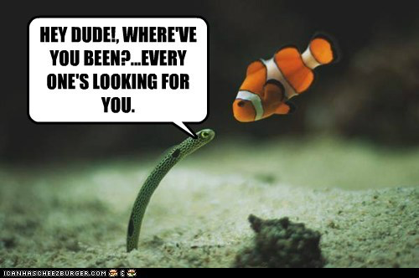
^
mostly

Slide 3
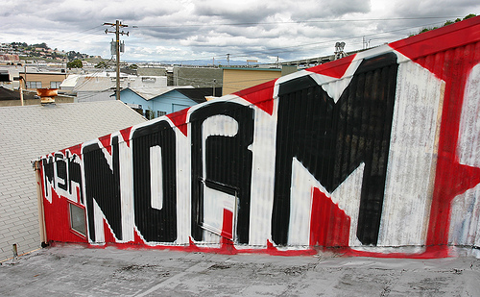

Slide 4
All opinions count;
Keep an open mind
Focus on the kids
Keep side conversations to
a minimum (keep them on
topic and not distracting)
Clear communication
(ask for clarification)
Maintain trust; what
happens here stays here
Do what works
(honor different modalities)
Actively listen and participate
Be yourself (Stay true to your idea and passion)
Make decisions by consensus
Phones on silent
Use your technology for relevant topics (emergencies and family concerns OK)
Be open to ideas;
use what you learn
Respect time

Slide 5
Overview…
Agenda
Materials
Logistics
Outcomes
Wi-Fi Password:
SCUSD Wireless Security
There is a space between each word and it is case sensitive

Slide 6
Today’s Outcomes…
Identify tangible ways that you’ve implemented Action Civics Principles in your classroom;
Learn about the importance of creating and fostering community partnerships;
Learn a strategy to map your community’s assets and needs; and
Identify a problem, issue, or concern that your team will address in the coming year.

Slide 7
Reflection
Activity

Slide 8
Take time to look back...
Reflect with your team:
What have we covered in our PD sessions together?
Our PLC time at our site?
What have we done in support of the Action Civics Initiative at our school?
Celebrate your successes and be amazed at how far you’ve come!
Identify THREE tangible strategies, activities or tools that you’ve used in the past year.

Slide 9
Now looking forward...
Thinking about your successes, identify TWO tangible strategies, activities or tools that you want to use or improve upon next year.
“The most important question is not the one you just answered, but the next one you ask.”
Thinking about the Summer Institute and beyond, identify ONE topic, strategy, or resource you want to explore in more depth.

Slide 10
SHOWCASE it...
Using the brainstorm sheet as a guide, showcase your 3,2,1 on chart paper.

Slide 11
SHOWCASE it...
Using the brainstorm sheet as a guide, showcase your 3,2,1 on chart paper.

Slide 12
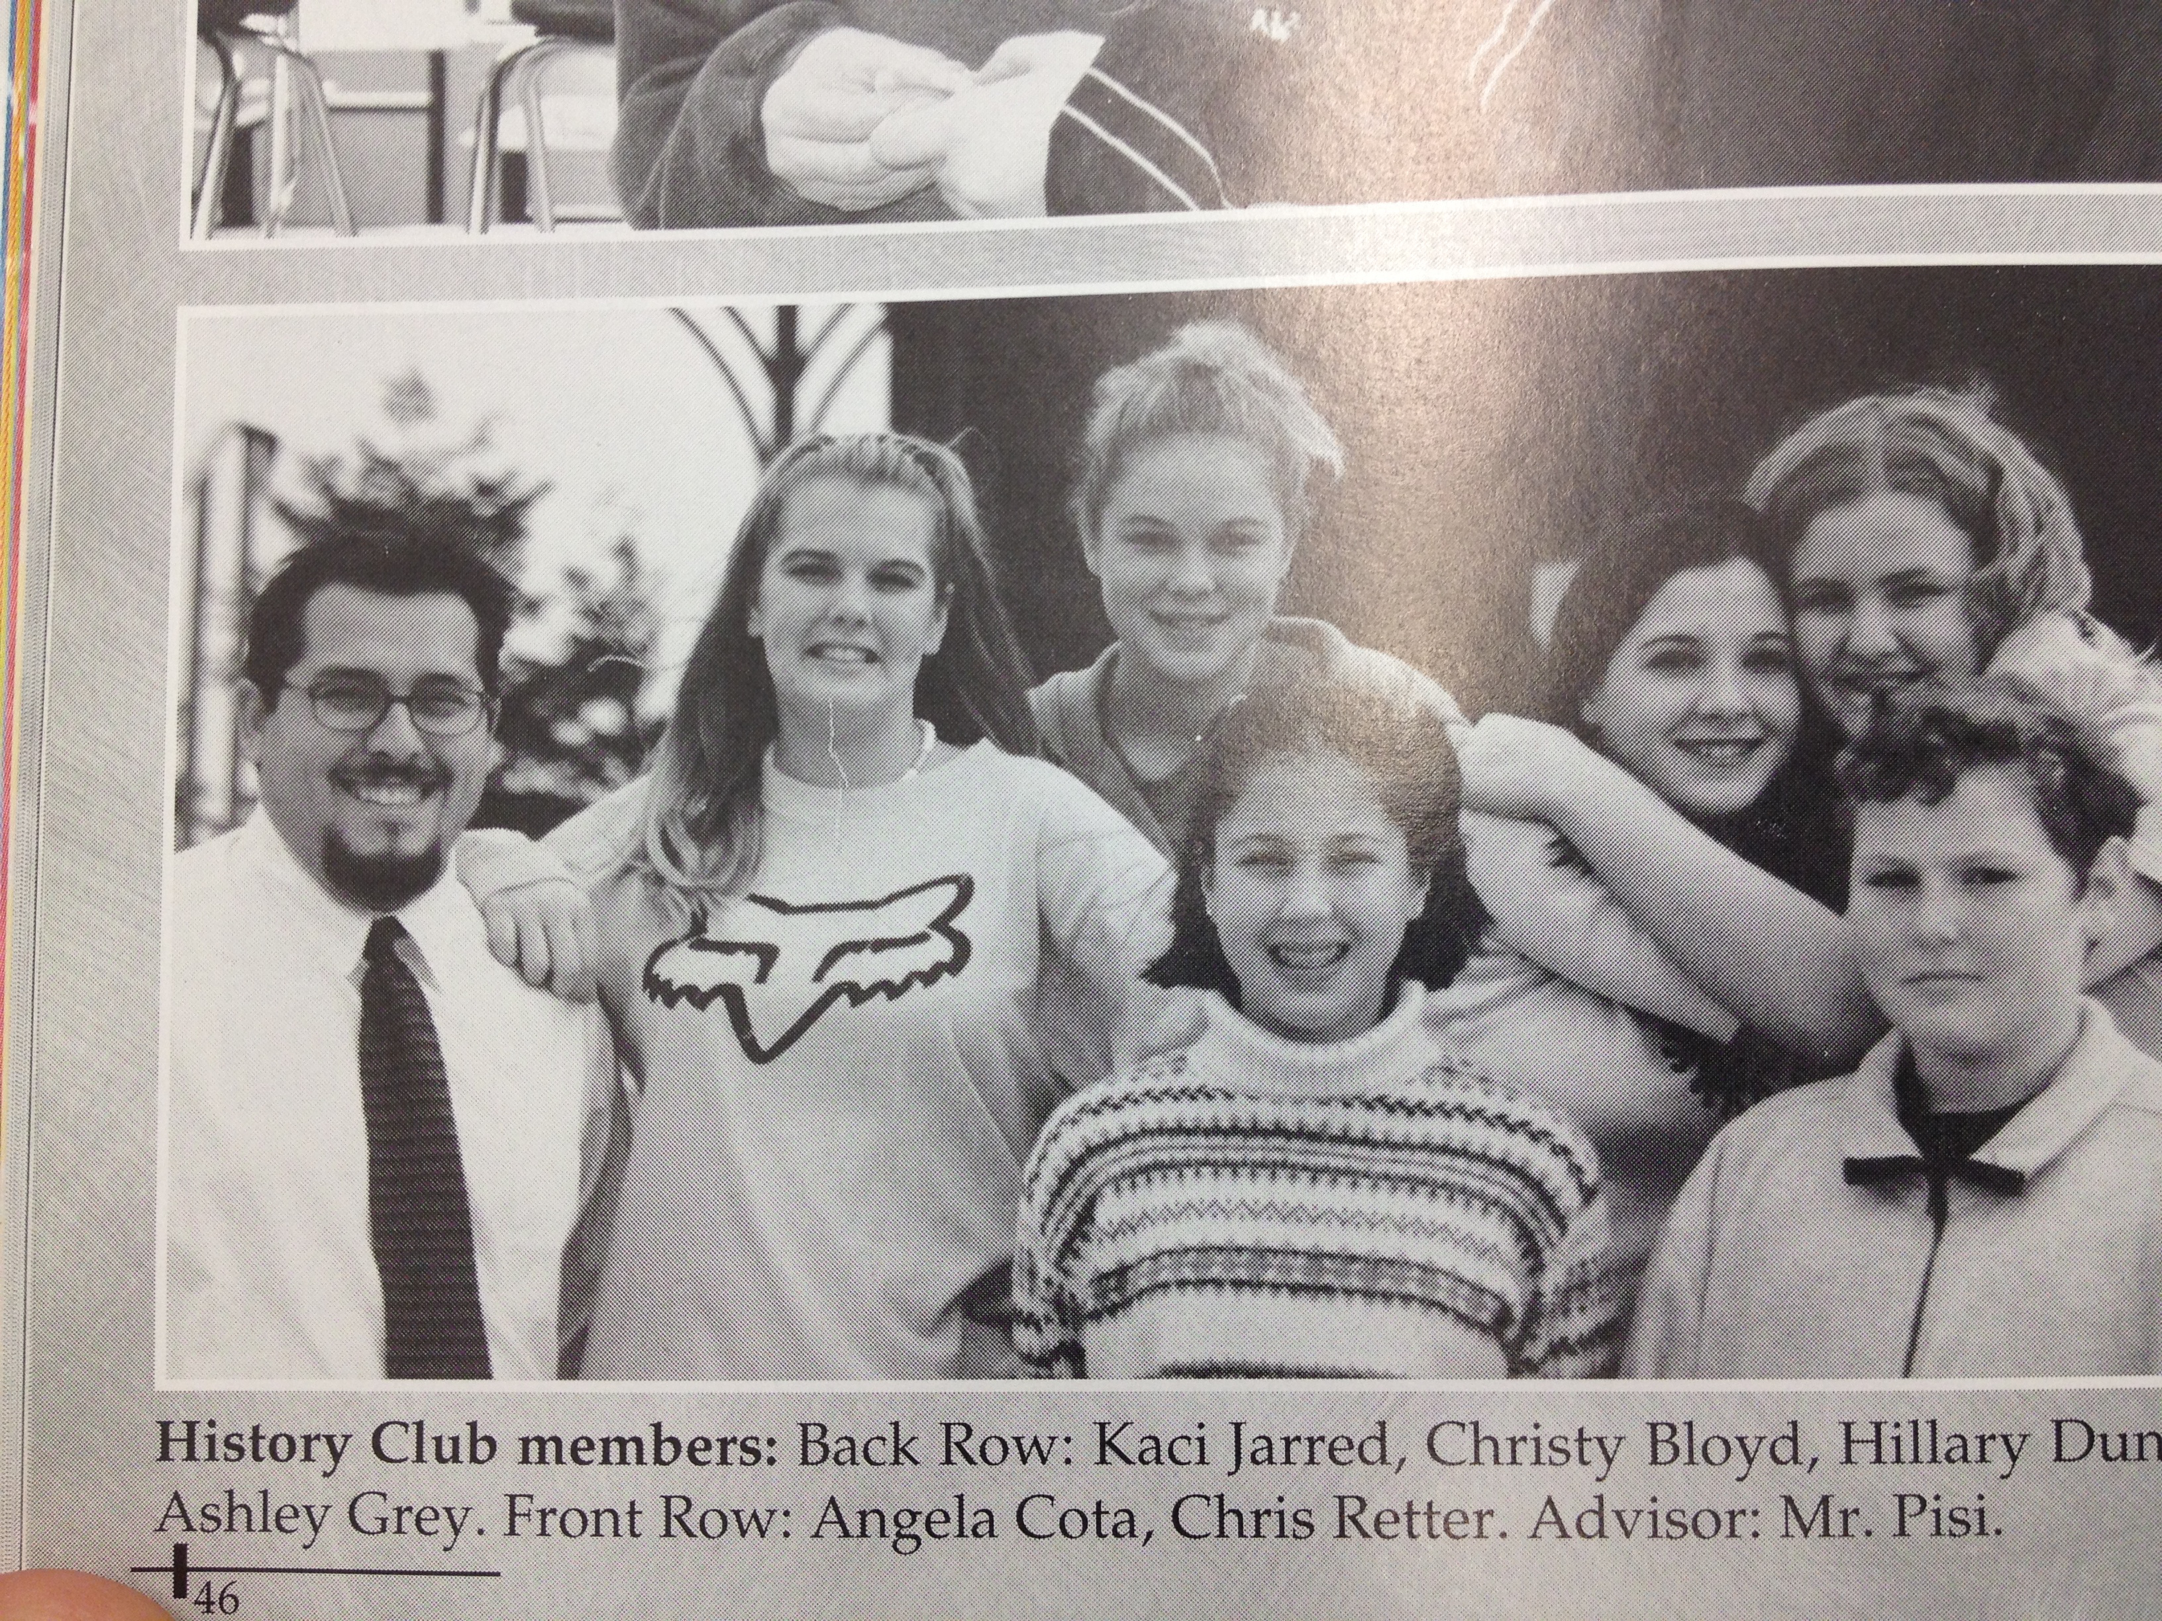
The rest of the team visits the other sites’ work…
One member of your team stays with your chart paper…
Ask questions, give high 5’s and advice.

Slide 13
Deeper Dives…
Increase student Involvement in PBL, Socratic Seminar, Service Learning in the community
Establish an Action Civics Class (how to get kids involved?)
More team planning time
Community Partnerships
Civic Learning and Advocacy Projects
PBL- How to select a theme
Engagement Strategies
Action Civics in a club setting
AVID Strategies

Slide 14
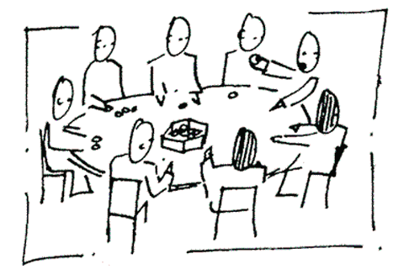
Breakout Discussions
Focusing on the ONE topic or concept you’d like to explore further during the Summer Institute and beyond.

Slide 16
Community Partnerships

Slide 17
Finding the Pieces...

Slide 18
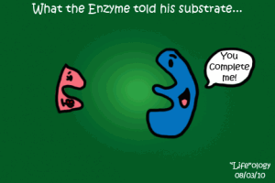
Find your team...
Find the members of your team that will help you complete your puzzle

Slide 19
Now let’s debrief

Slide 20
Why Community Partnerships?
Benefits of an effective community partnership…

Slide 21
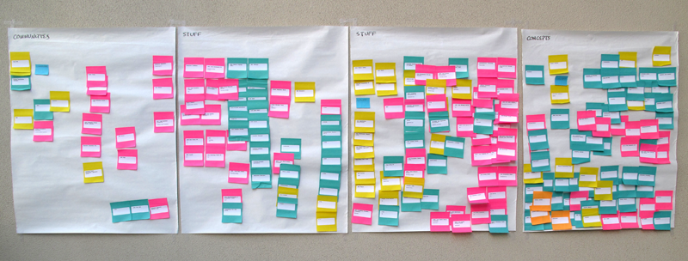
Asset Mapping One Approach- The War Board

Slide 22
Asset Mapping One Approach- The War Board
Needs...
Students
Community
Classroom
Assets...
People
Organizations
Associations

Slide 23
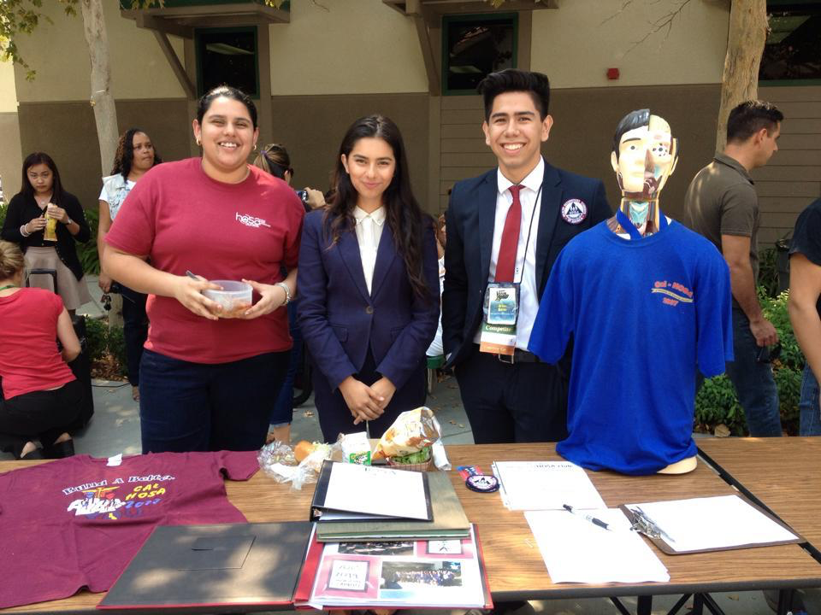
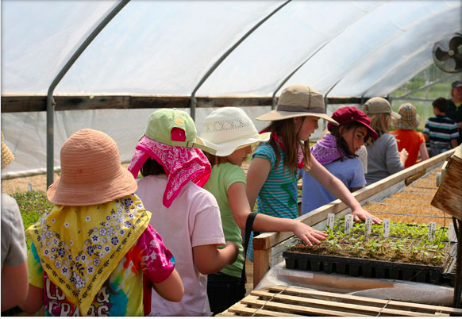
Community Partnerships in Action...
Health Professions
High School
Alice Birney
Waldorf K-8

Slide 24
LUNCH!

Slide 25
Consider Action Civics as a process...
Identify a Problem, Issue, or Concern
Take a Stand
Develop a Strategy
Act
Reflect

Slide 26
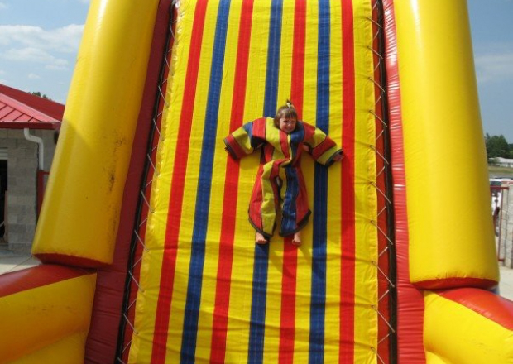
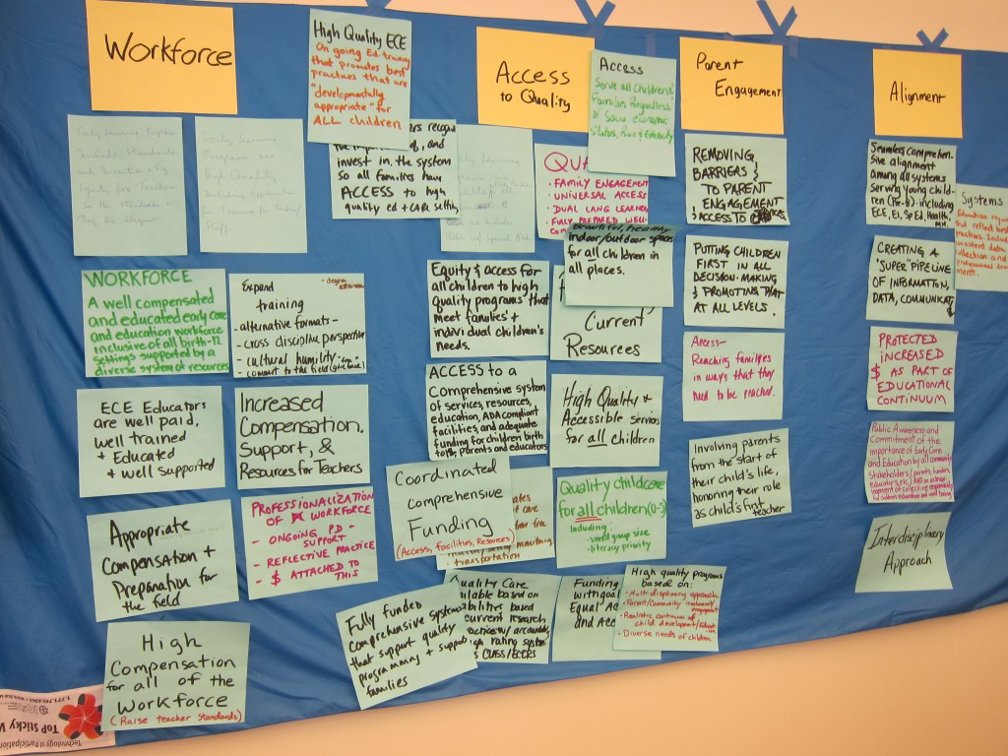
The Sticky Wall!
In your teams, identify any tool, strategy, or resource you’ve used to help students with each “step” in the Action Civics process.
Write one tool, resource, or strategy per note card and stick it under the appropriate step.

Slide 27
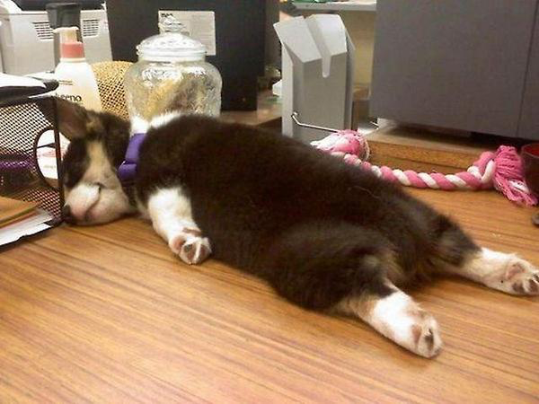
NAP Break
time...

Slide 28
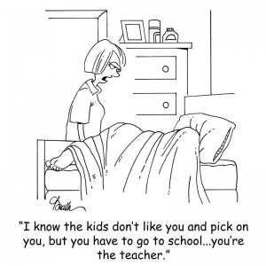
You’re the Student...
Action Civics Process Outline
As a team, identify a “problem, issue, or concern” that you want to address.
Develop a corresponding compelling question.

Slide 29
Now, take out your phone, laptop, or tablet...
Meeting Evaluation:
Please visit: https://www.surveymonkey.com/s/CIVICS_PD_Feedback_Form

Slide 30
Next Steps...
Critical: Maintain sanity through the end of the year
Team Leads: Schedule your MAY MEETING with Frank and your team
Team Focus: Finish strong. Look toward the Summer Institute
Visit the Action Civics Website for resources to support your efforts!

Slide 31
Next Session...
Summer Institute
July 20-24
Location: To Be Determined
Time: 8:30 am – 3:00 pm

Slide 32
In summary...

