Slide 1
Action Civics Initiative Site Team Orientation
February 28, 2015
Sacramento County Office of Education
8:30 am – 3:00 pm

Slide 3
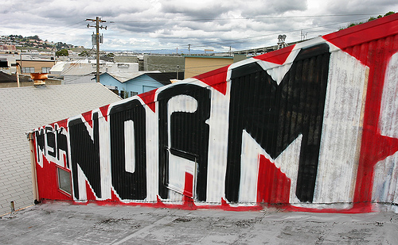

Slide 4
Overview…
Agenda
Materials
Logistics
Outcomes
Action Civics Initiative Website:
www.scoe.net/actioncivics

Slide 5
Today’s Outcomes…
Become familiar with the elements of Community Service, Project Based Learning, and Service Learning
Begin to identify the CIVICS SKILLS that students need to succeed in college, career, and life

Slide 6
Melissa Neuberger, Program Manager
Center for Student Assessment and Program Accountability
(C-SAPA)

Slide 7
New Standards, New Assessments: How Does Action Civics Fit In?

Slide 9
STAR assessments focused primarily on DOK 1; DOK 2 were the most difficult questions
Most of Smarter Balanced assessment questions are in DOK 3 (between 43-49%) and DOK 4 (between 21-25%)

Slide 11
Preparation for Future Success

Slide 12
English-Language Arts Key Shifts and Assessment Focus

Slide 15
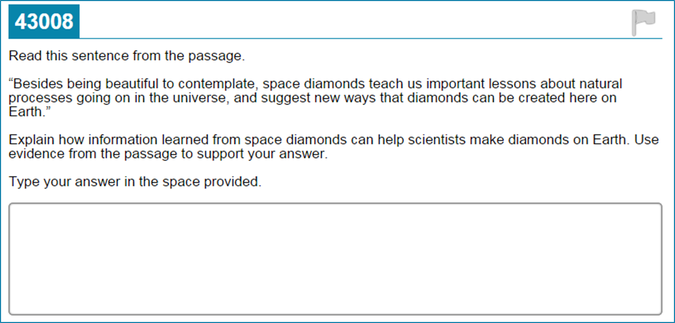
What is Different: English-Language Arts

Slide 16
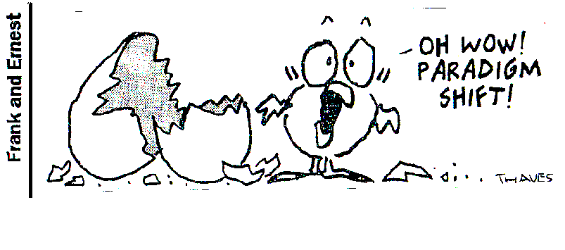
Mathematics Key Shifts and Assessment Focus

Slide 19
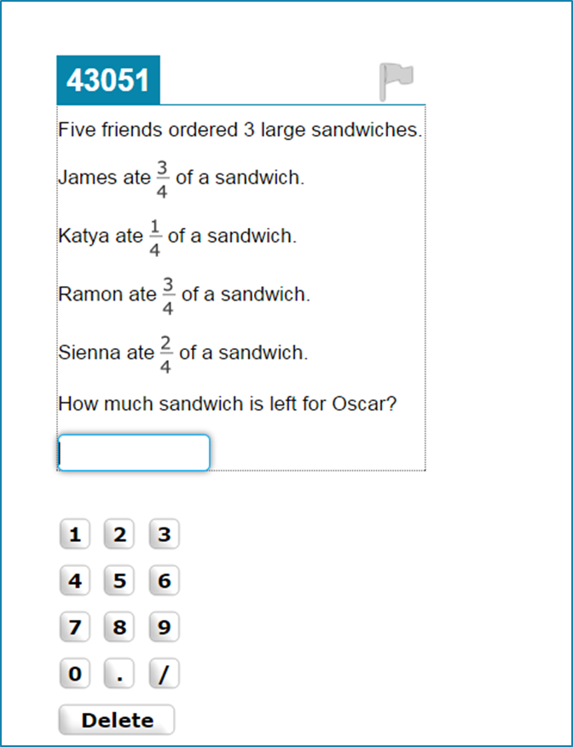
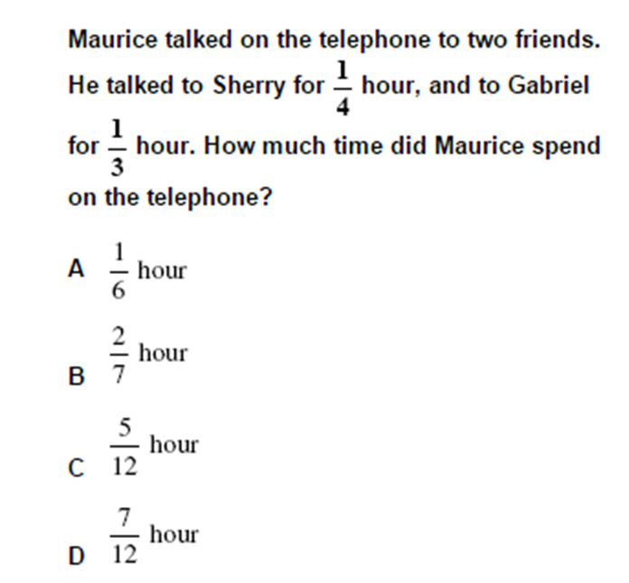
What is Different: Mathematics

Slide 20
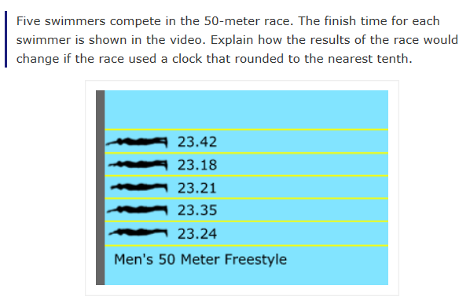
What is Different: Mathematics
I Choose ‘C’ Video
(click the graphic above)

Slide 21
Walk-around Activity

Slide 22
The Spectrum of Student Engagement…

Slide 23
The Spectrum of Student Engagement Opportunities
More
Complexity of Activities
Less
‪Extra curricular activities (clubs and after school programming)
Leadership (advisory groups)
Fieldtrips
Internships
Advocacy
Student Government
Community Service/Volunteering
Service Learning
Project-Based
Learning
Simulations
Civil Protests
Community events/ meetings
Speakers
Forums programs (OPD, Open Door, LegiSchool and Next 10)
Considerations to make when developing or selecting engagement opportunities:
‪Degree to which it is internal to the classroom vs. within the community.
Is it theoretical versus real life?
‪Degree to which it is adult driven versus youth driven.

Slide 24
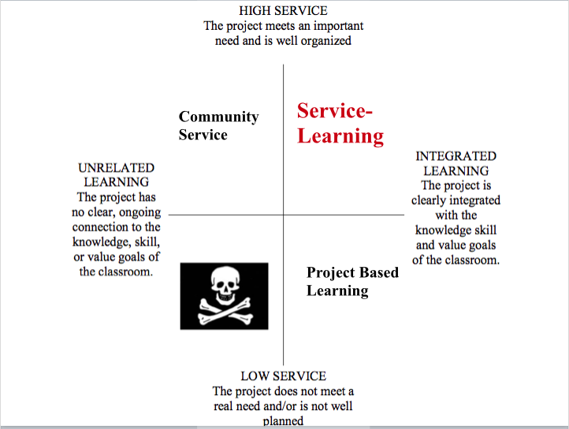
Another way to look at it…

Slide 25
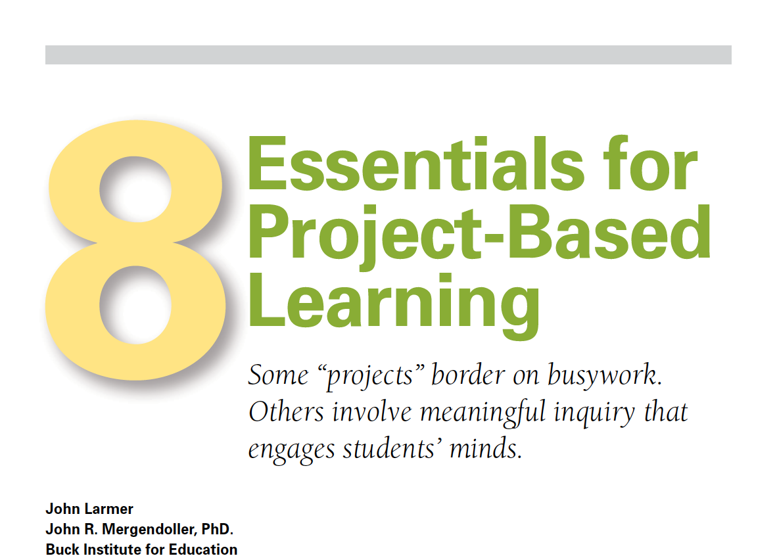
Let’s Discuss…

Slide 27
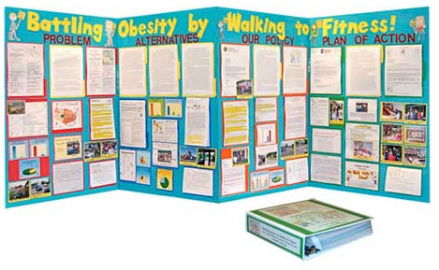
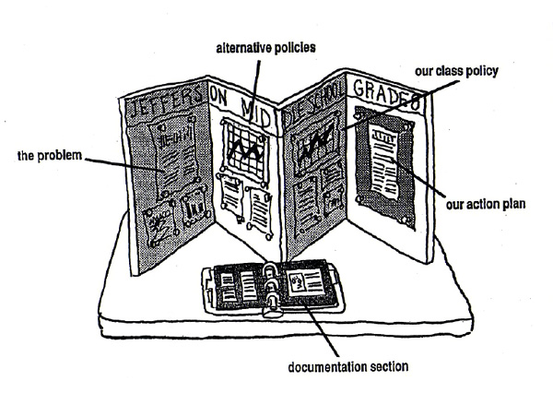

Slide 28
Can We Believe This?

Slide 29
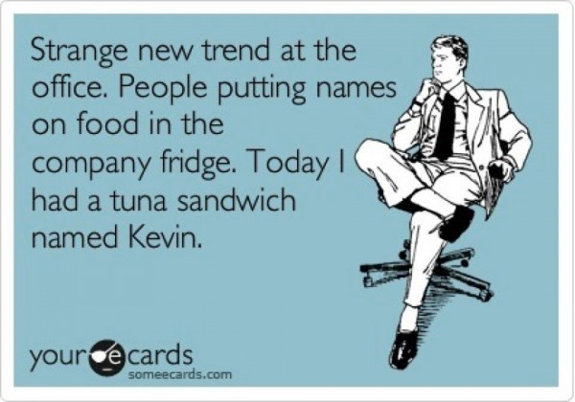
LUNCH!

Slide 30
Karen Green
Peercourt.com

Slide 31
Discussion Question: How is Community Service Different than Service Learning or Project Based Learning?

Slide 33
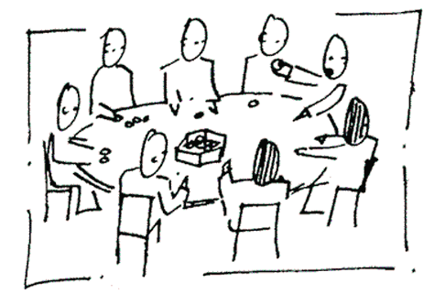
Roundtable Discussions

Slide 34
Now, take out your phone, laptop, or tablet…
Meeting Evaluation:
Please visit: https://www.surveymonkey.com/s/CIVICS_PD_Feedback_Form

Slide 35
Next Steps…
Enjoy your Winter Break!
Team Leads: Schedule regular meetings between Frank and your team
Team Focus: Incorporate Six Proven Practices into YOUR practice
Dream Big!
Visit the Action Civics Website for resources to support your efforts!

Slide 36
Whole Group Discussion

Slide 37
Next Session…
April 18, 2015
Focus: Community Partnerships
Location: To Be Determined
Time: 8:30 am – 3:00 pm

